Slide 1


Traffic light System
Microcontroller
Presentation to
Prof Dr. Stefan Henkler
Presentation by:
Danish Zaheer Malik

Slide 2
Motivation
To make a traffic light system.
Adding a pedestrian Light system.
Coordinating 2 traffic light systems.

Slide 3
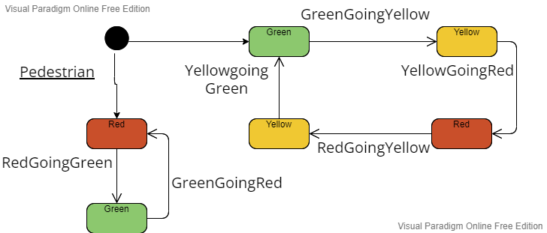
State machine Diagram

Slide 4
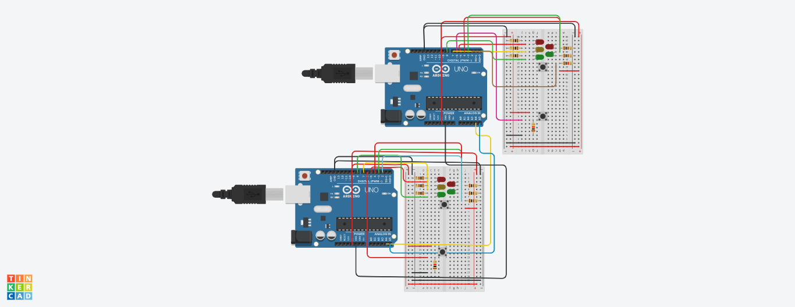
Circuit Of TLS

Slide 5
Communication
Via Inter-Integrated Circuit (I2C)
Advantages
Only uses two wires
Supports multiple masters and multiple slaves
Hardware is less complicated than with UARTs
Well known and widely used protocol

Slide 6
Communication
Via Inter-Integrated Circuit (I2C)
Dis-Advantages
Slower data transfer rate than SPI
The size of the data frame is limited to 8 bits
More complicated hardware needed to implement than SPI

Slide 7
References
https://www.circuitbasics.com/basics-of-the-i2c-communication-protocol/
https://www.watelectronics.com/how-traffic-light-control-system-works/

Slide 8
The End

Slide 9
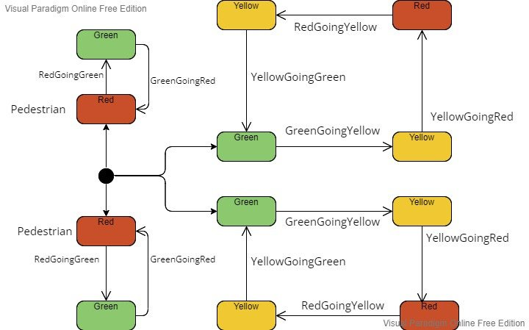
Backup

